Slide 1

Crop Production in India
Analysis On

Slide 2
INTRODUCTION
Agriculture is the backbone of the Indian economy, employing over 50% of the workforce.
Agricultural sector contributes around 17-18% to India’s GDP.
India has a diverse range of climatic zones, supporting a wide variety of crop production.
Both irrigation based and rainfed agricultural practices are prevalent throughout the country.
The major challenges in this sector include climate change, water scarcity, small landholdings, and dependency on monsoon.

Slide 3
ABOUT DATA & PROBLEM STATEMENT
This dataset provides over 2 lakhs records of information on crop production in India ranging from several years.
Includes States of India , Districts within each states , Year of production , Season with wide range of crops cultivated , area under cultivation in hectors and crop production in quintals.
Based on the Information the ultimate goal would be to predict crop production and find important insights highlighting key indicators and metrics that influence crop production.

Slide 4
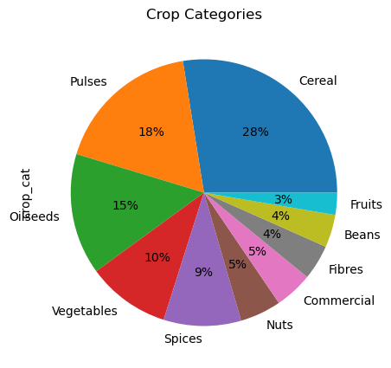
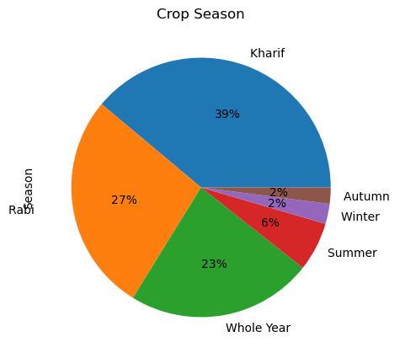
OVERALL OBSERVATIONS ON DATA
India produces approximately ten categories of crops: cereals, pulses, oilseeds, vegetables, spices, nuts, commercial crops, fibers, beans, and fruits.
The leading crop categories are cereals and pulses.
Most crops are cultivated during the Kharif season, with the least crop production occurring in the autumn and winter seasons.

Slide 5
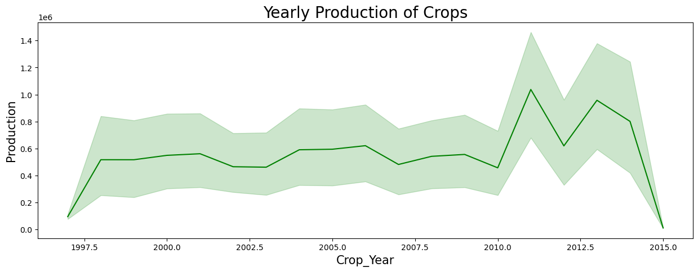
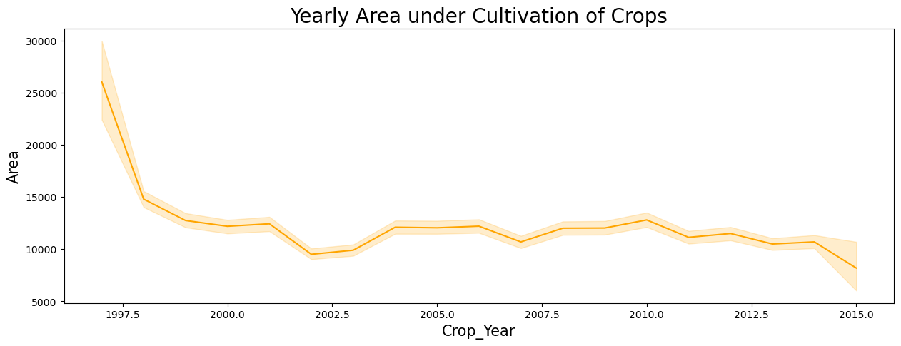
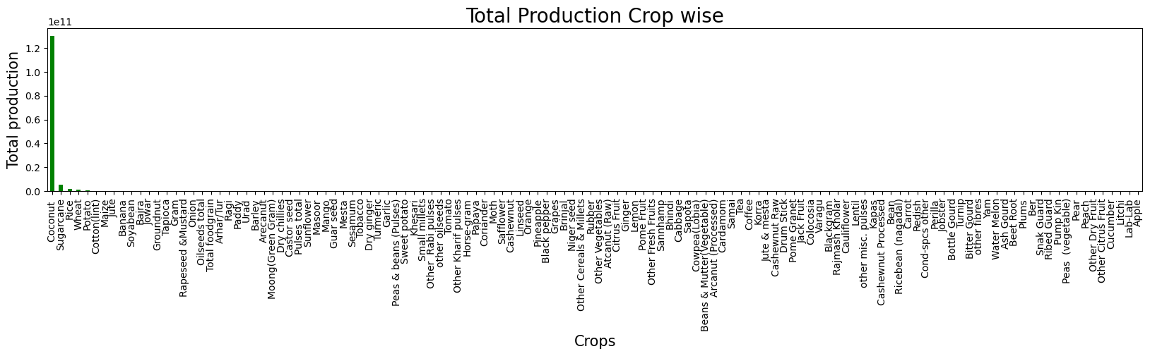
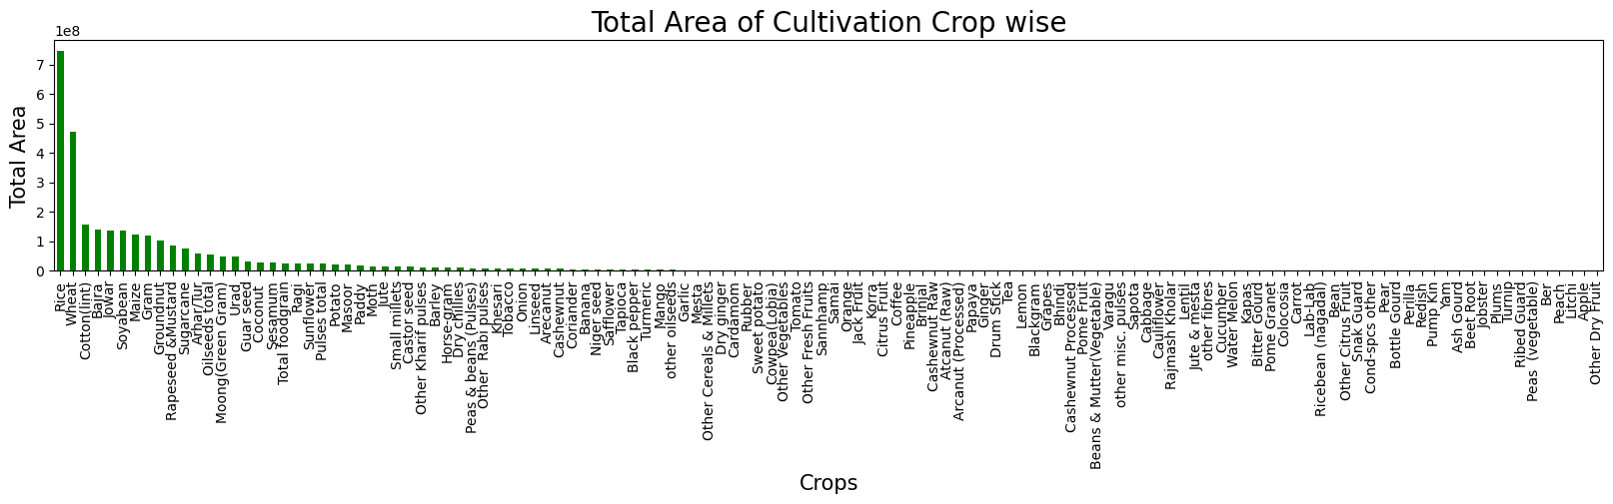
Peak production of crops was achieved in 2011.
From 1997 to 2000, there was a significant decrease in the area of crop cultivation.
In terms of production , Coconut is the highest-producing crop in India.
Area of cultivation for Rice is largest throughout the country.

Slide 6

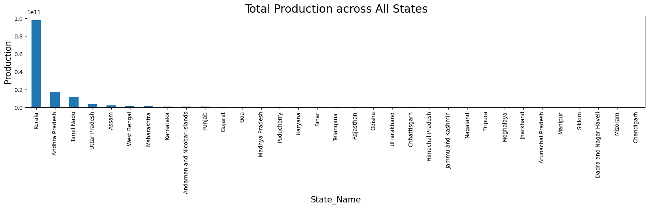
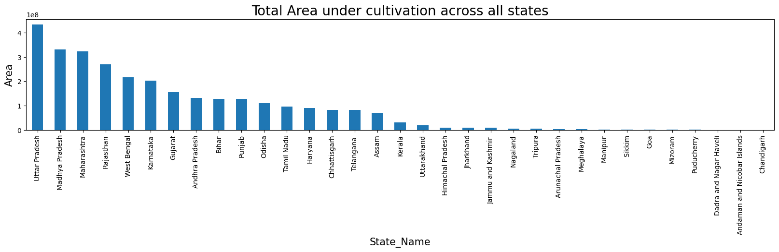
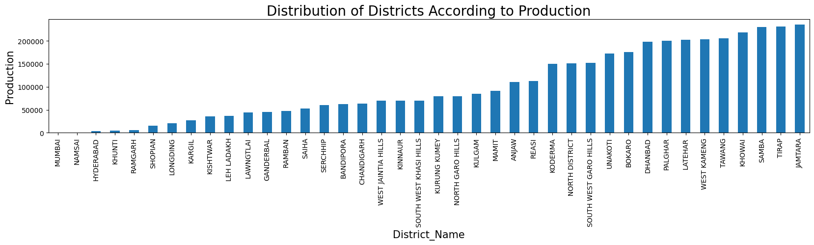
Kerala is highly producing state in the country while Chandigarh is lowest in production of crops.
After observation we can see top 3 states in crop production are from south region of India.
In terms of crop cultivation area, Uttar Pradesh tops the list followed by Madhya Pradesh and Maharashtra.
Mumbai district has little to no crop production compared to other districts of India

Slide 7

ANALYSIS ON TOP PRODUCING CROPS
Coconut
State : Coconuts are predominantly produced in the state of Kerala, with the top three coconut-producing states located in southern India.
District : Kozhikode district from Kerala is highest in coconut production throughout the country.
Crop Year : Over the years, coconut production has increased, reaching its peak in 2011.
Season: Coconuts are produced year-round, especially during the kharif season.
Area: Total 28 mha area is occupied by coconut cultivation.
Coconut production largely depends on factors such as season, area, and location.

Slide 8


Sugarcane
State: Sugarcane is extensively produced in Maharashtra, but the area under sugarcane cultivation is larger in Uttar Pradesh.
District: Muzaffarnagar is the highest sugarcane-producing district.
Crop Year: Since 1998, sugarcane production has been increasing.
Season: It is mainly grown during the kharif season across the country.
Area: Total area under cultivation for Sugarcane production is 76 mha.
Sugarcane production largely depends on factors such as season, area, and location.

Slide 9
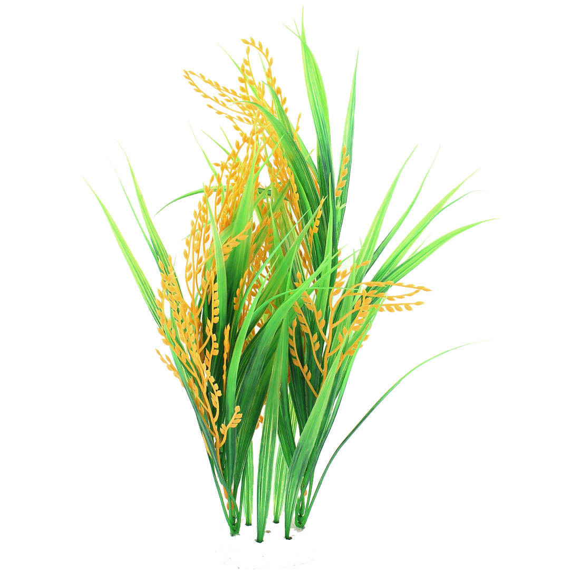
Rice
Rice is one of the staple grain crop produced on large quantity in India.
State: Rice is largely produced in the northern part of India. The highest producing state is Punjab
District: Highest rice producing district is Bardhaman in West Bengal.
Crop Year: Rice production has been increasing over the years.
Season: It is mainly grown during the kharif season across the country
Area: As the area under cultivation increases, rice production also rises.Total rice cultivation area is 746mha.
Rice production largely depends on factors such as season, area, and location.

Slide 10







ANALYSIS ON CROP SEASONS
Kharif Season:
Area Under Cultivation is 1403 million ha.
Highest producing state is Punjab.
Mostly Produced crop is Sugarcane.
Rabi Season:
Area Under Cultivation is 947 million ha.
Highest producing state is Punjab.
Mostly Produced crop is Wheat.
Autumn Season:
Area Under Cultivation is 48 million ha.
Highest producing state is Bihar.
Mostly Produced crop is Rice.

Slide 11



ANALYSIS ON TOP STATES IN CROP PRODUCTION
Kerala:
Kozhikode district leads in crop production.
Coconut is extensively grown.
A larger area is cultivated during the kharif season.
From 1997 to 2012, production remained constant.
Punjab:
Sangrur district leads in crop production.
Wheat is a highly grown crop.
Larger area under cultivation is seen in rabi season.
Area under cultivation is constant.
Maharashtra:
Highest crop production seen in Kolhapur District.
Sugarcane is highly grown crop.
A larger area is cultivated during the kharif and rabi seasons.
In 2006, there was a significant drop in the area under cultivation.

Slide 12
CONCLUSION
States in southern and northern India generally have higher crop production.
Crop production is heavily influenced by seasonal variations and climate change.
The Kharif and Rabi seasons are the most suitable for farming in India.
The area under agricultural cultivation has been decreasing since it peaked before the year 2000.
Crop production increases as the area devoted to crop cultivation expands.
The Kharif season has the greatest area under cultivation.
India is a leading producer of cereals (rice and wheat) and commercial crops like sugarcane.
Coconut has the highest production in southern states and also holds a significant position in Indian agriculture

Slide 13


Save Farmers , Save Agriculture !
THANK YOU

